Slide 1
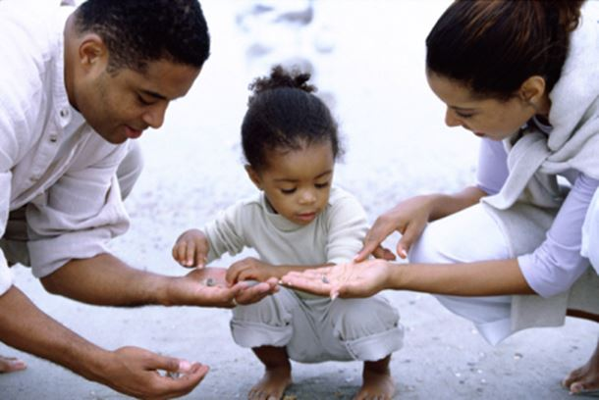
Session on Parenting
Parents
and Children
Dra. Paula Sousa-Psicóloga dos Serviços de Psicologia e Orientação
Escola Básica e Secundária Dr. Jaime Magalhães Lima
9th November 2018

Slide 2
Personal presentation
I am _________________________________________
and my son / daughter is ____________________________
And his/her quality is _______________________________
In this session I would like to talk about __________________
________________________________________________________________________________________________

Slide 3
What is parenting?
“Positive Parenting is defined as parental behaviour based on the best interest of the child that is nurturing, empowering, non-violent and provides recognition and guidance which involves setting of boundaries to enable the full development of the child.”
(Council of Europe launched Recommendation, Lisbon 2006)

Slide 4
Why?

Slide 5
Child Development Skills
Social & Communication
Emotional
Autonomy
Problem Solving

Slide 6
Positive Parenting

Slide 7
Competencies to be Developed
Recognise the importance and the need to establish rules and limits to the children’s/youngsters’ behaviour, in a strong and consistent way;
Know and develop strategies to deal with children’s/youngsters’ innadequate behaviours (ex.: suport/compliment, active ignoring, time-out, consequences);
Be aware of the importance of the non-verbal communication as well as the expression and sharing of affection in the emotional development and bonding in the child/youngster;
Understand the importance of educating positively and knowing strategies in order to make it possible;
Know both the evaluation and intervention processes in the promotion of a positive parenting.

Slide 8
Family: A Systemic View
Family is a system that integrates several subsystems: Individual, Conjugal, Parental, Filial, Fraternal;
Limits, roles/functions and specific routines (Minuchin, 1982).
Supports the children’s development, education and socialization, including their physical needs, stimulation, emotional support, learning opportunities, moral orientation, resilience and self-esteem (Relvas, 1996);
Supports the child during his/her autonomy/individuality – structuring the environment, monitoring and supervision (Bradley, 2002).
PARENTAL SUBSYSTEM NOURISHING, GUIDING AND CONTROLLING

Slide 10
Family: A Systemic View
Family life cycle: Family evolution along the time is characterized by different stages:
Couple formation
Family with little children
Family with school-age children
Family with teenagers
Family with adult children
Tasks
Challenges/Demands
Times of crisis
Needs

Slide 11
Need of… “A range of educational and supportive activities which help parents and prospective parents to understand their own social, emotional, psychological and physical needs and those of their children, and which enhance the relationship between them.”
(Pugh et al, 1997)

Slide 12
Being a Parent Today
New family types or changes within the family structure/shape – more divorces and single-parent and rebuilt families;
Drug use, delinquency, violence, early school leaving;
Raise of precarious employment, unemployment and, consequently, of economic difficulties;
Parenting abuse and neglect, emotional problems of both children and adults, as well as a very high incidence of teenager pregnancy;
Individualism and competitiveness;
Difficulties in conciliating family life and professional career;
Parents’ limited availability, low empathy towards their children’s needs, along with difficulty in keeping a consistent affection and bond.

Slide 13
Intervention on Parenting
Giving each family the needed psycho-socio-educational support;
Mobilising family’s competencies and energies, based on parents’ abilities, or someone replacing them, and on family characteristics and dynamics;
Preserving parents’ educative responsability, empowering their parenting abilities.

Slide 14
Towards a more Positive Parenting
Affection
Protection
Attention
Positive orientation
Support
Acceptance

Slide 15
Care/Love
Giving care to our children is the first step of the parents that wish to educate their children correctly.
Affection and love are the first stimuli the child needs to get since the day he/she is born.
Without these stimuli his/her good emotional development will be much more difficult.

Slide 16
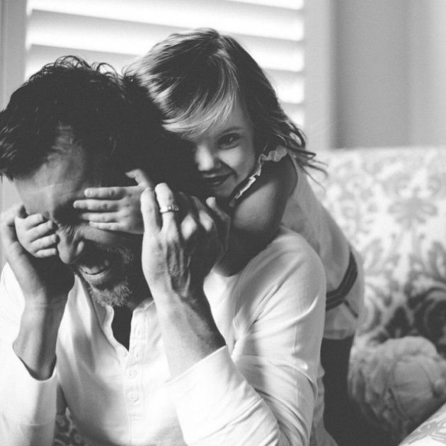

Slide 17
Authority
Authority is the second basis to know how to educate children.
During the child’s development, authority is essential to reach emotional balance.
If there are no limits, children get lost in a world full of possibilities and stimuli.

Slide 18
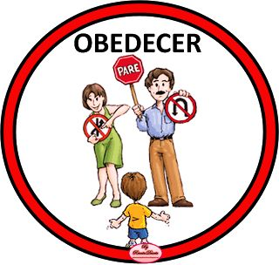
Rules and Limits
The rules and limits are essential for children to learn how to self-control, to know what is right or wrong, this way making easier the living inside and outside the family circle.
After setting/knowing the rules, life becomes easier for both parents and children.
OBEY

Slide 19
Rules provide safety, as long as they are needed, stable and do not repress too much the children’s sphere of activity.
Children accept the rules much easier and with no objection if they are shown in a clear, safe and constructive way, giving more emphasis on what is allowed instead of on what is forbidden.
Whenever possible, inform when the time to do something is approaching and so the order you had given will have to be obeyed.
This way, children start getting ready to finish what they are doing and start developing the notion of time.
“In 5 minutes it’s time to pack the Legos.”

Slide 20
Give clear orders
Keep a permanent dialogue.
Use a language appropriate to the child’s age and a firm tone.
When giving an order, look into the child’s eyes
You need to be persistent, but psychologists say it works:
“Tell the child what to do only once.”
Take some minutes and check if the child has already done what you have asked them to. If not, take their hand and monitor them while doing it.
Repeat the same action until the child start doing it by their own.

Slide 21
The importance of giving orders…
Orders can not be contradictory.
It’s important the coordination between father, mother, uncles/aunts and grandparents.
Sometimes one of the parents give an order and the other gives a different one right after without knowing about the previous one.
This makes the levels of disobedience and struggles rising among the family.

Slide 22
It’s essential that adults support eachother about the orders previously given;
It’s important to check if the children have already finished a previous order before being given another;
Fulfilling or not fulfilling given orders must have consequences;
After giving an instruction, there must be a consequence or accountability for its non-compliance.

Slide 23
Clear Consequences
Rules can not be circumvent nor the limits can be challenged without having to deal with its consequences.
Even if it is hard for you, consequences have to exist – noone has ever said that disciplining would be easy, but more important than that is to be effective.
It will worth it in long-term.

Slide 24
Examples of verbal compliments:
Congratulations!
It’s amazing when…
I like when…
Fabulous!
You have done all this by yourself… Well done!
That must have been a lot of work!
You have worked really hard to…
Once you have behaved so well, you and I are going to…

Slide 25
If the child asks you to play, instead of saying.
“I’m coming!”
Be more precise and tell them:
“Give me 5 minutes and then I’ll play with you.”
When the child spills juice while they are drinking it… instead of saying: “Be careful, you keep on doing it!”
Try to say:
“Hold the glass with your both hands.”
When it is time to pack the toys… maybe it would work quite well saying:
“Let’s pack the toys.”
instead of:
“It’s time for you to pack all your toys.”

Slide 26
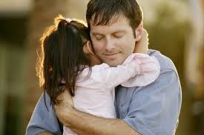
Non-verbal compliments you can try to do with your children:
- Hug
Caress their face or hair/head
Put your arm on the child’s shoulder
Smile
Kiss
Do the “cool” sign
Blink an eye
“Give me five”

Slide 27
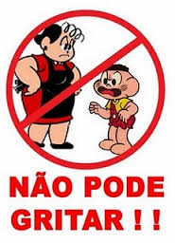
The respect
Teaching the child how to respect not only the adults, but all the people around her means learning simple things like saying:
Not yelling nor beating are other kind of attitudes
that must be controlled/avoided
Thank you
Excuse me
Please
I’m sorry
Good morning
Good afternoon
Good evening
See you later
You can’t yell!

Slide 28
Be part of the model…
Children observe and do/imitate everything they see in the world of the adults, so if you are always yelling at children, they will think there is nothing wrong about doing it and will be the exact mirror of that kind of behaviour.
By taking a deep breath and thinking twice before talking, you can do it calmly, showing the child that is the way they should talk and behave themselves.
It is up to you to establish the tone in every situation, and this is the path children will follow.

Slide 29
Give emphasis to the behaviour you want to see and not what you don’t want to see
When we think about disciplining children, the word that comes immediatly to our mind is “No”. However, it must be replaced by “yes” whenever possible, this is, changing “You mustn’t” by “You must” makes it easier for the child to learn.
For exemple, instead of saying “Don’t push your little cars against the table” say “by doing that, you will damage the table. Play with your little cars on the floor, they will run faster!”.

Slide 30
Find out the causes of…
If the bad behaviour persists and all the discipline actions are being unsuccessful, it is important to assess the situation and understand exactly the reason behind the disobedience:
Is there something wrong at school?
Is the child not feeling good?
Have they been sleeping enough?
Bad behaviour is not always a child’s whim, so, talk with your child when they are calm down and try to know what is going on and the best way to solve the situation.

Slide 31
Create a good emotional bond
Show affection, talk and play.
By doing this, you will build a greater empathy with your child.
Being sure that they have their parents’ attention, they learn they don’t need to be disobedient in order to get their attention.
This way, when you need to impose a rule, the child will understand much easier that there are moments when they have to obey.

Slide 32
Appreciate the child’s role
Your child needs to know their importance in the family and the place they have on situations of family sharing.
For that, it is good for the child to have their own place at the meals table and that they are heard by their parents.
“A child must know that obeying their parents contributes to the development of a harmonious family dynamics, in which everyone is rewarded.”

Slide 33
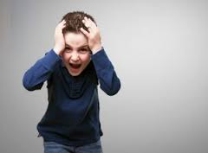
Be firm…
The secret behind the success of child’s discipline is the ability to keep firm – e.g., if the child knows already they can’t take toys to school, don’t give in just because they decide to make a huge tantrum.
If 9h30pm is time to sleep, don’t give in because the child wants to play a bit more.
At the very time you give in, the child will keep on testing the limits on and on.

Slide 34
I love you!
Being firm does not mean you can’t tell the child how much you love them or hug them right after warning them because of a bad behaviour or explaining why you did not appreciate a certain action or word.
It is even an interesting way of showing the child that discipline does not mean you love more or less and that, despite the conflicts, everything will be alright.

Slide 35
Create a routine
Use your good sense and establish a routine to your child.
Routine is essential as it brings safety to the child and makes them feel well cared.
Gradually, give them some autonomy to do little things by themselves. A child likes to feel they are able to do something.
A routine well adapted to the child’s rythm reduces anxiety, makes them remembering some of their daily tasks, such as brushing their teeth after the meals, and having a sleep quality.

Slide 36
Routines
Telling a story
Reading a story
Talking about a special place with your child
Walking around with your child
Creating hygiene and cleanliness habits

Slide 37
Meals
Make of your meals a moment of pleasure.
During meal time, never talk about an unpleasant issue you know in advance it might create a discussion.
Be gentle and sit by the table with the purpose of making your family happy and sharing harmony, care and love.

Slide 38
Talk to your children in an open way
Do not keep sorrows or secrets nor avoid delicate issues.
Talk about everything, but choose the right moment for it.
When you feel your body is in an attack position, wait until you calm down, do a walk, have a shower, relax…
And only then you may talk.

Slide 39
Three tips to build a partnership between family and school
Know the school and understand its educational project, so that you are sure the institution meets the family’s expectations.
Keep in mind that school is an ally in the education of your child so build up a relationship based on mutual respect.
Only dialogue can solve misunderstandings about the exact role of both school and family.

Slide 40
So it will be worthwhile to…
Learn to explain how a child must do something, so that they learns about their limits and other social living rules.
Give some autonomy, so that the child learns how to do their own choices and be responsible for their consequences.
Not forget to make compliments, because when the child knows what their attributes are – as well as their faults – their self-esteem gets stronger.

